Slide 1

DataCo Smart Supply Chain Data Analysis.
Team Members:
Fayiq Ahmed K
Supriyo Dey
Sai Charan
Akhil Raj
Bharath

Slide 2
Problem Definition
Mapping out a supply chain is one of the critical steps in performing an external analysis in a strategic planning process. The importance of clearly laying out the supply chain is that it helps a company define its own market and decide where it wants to be in the future.
Detection of high risk (fraudulent) product category, products along with demographic characteristics and personal attributes of customer who are susceptible / contributing towards fraudulent activities.
High-risk payment modes (transactions) of DataCo Company.
Customer Segment through RFM Analysis.

Slide 3
Suggested Solution and EDA
Detection of high risk (fraudulent) product category, products along with demographic characteristics and personal attributes of customer who are susceptible / contributing towards fraudulent activities.
High-risk payment modes (transactions) of DataCo Company.
Customer Segment through RFM Analysis
Variable categorization (count of numeric and categorical)
No.of Numerical Columns: 29
No.of Categorical Columns: 24
Pre-Processing Data Analysis (count of missing/ null values, redundant columns, etc.)
We have dropped all the columns that were containing null values as those were not important for our targeted analysis.
Customer Email and Customer Password was having encoded characters.
Order Zip code and Product Description were blank columns
Product Image was having hyperlink.
Order Profit Per Order was same as Benefit per order.
Customer Street, Customer Names were not needed for analysis as we are having customer Ids
Latitude and Longitude were also not needed for analysis.

Slide 4
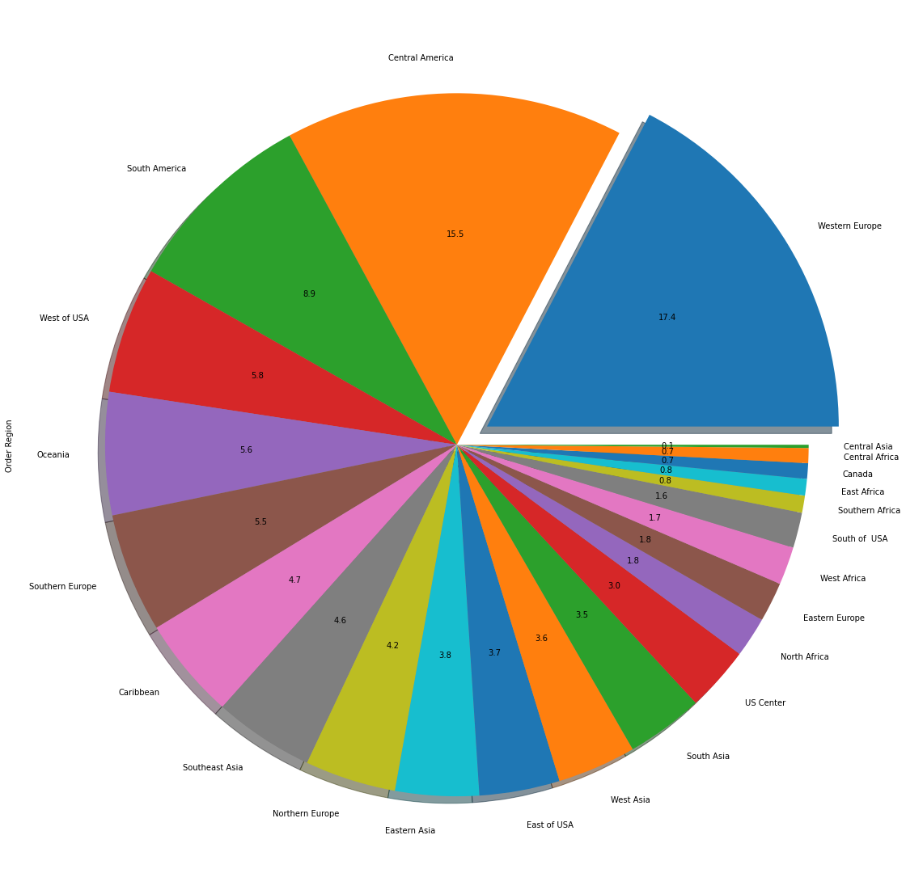
Suggested Solution and EDA
Univariate Analysis of target variable:

Slide 5
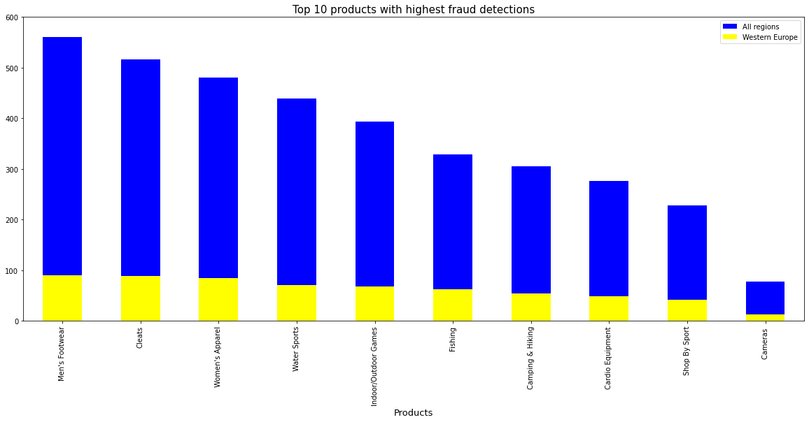

Slide 6
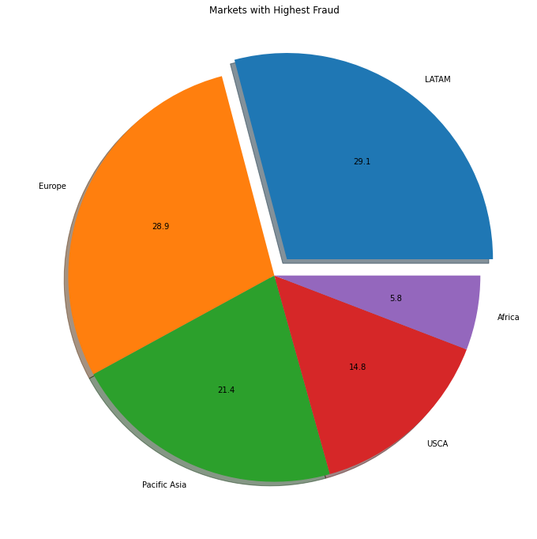
Markets with Highest Fraud

Slide 7
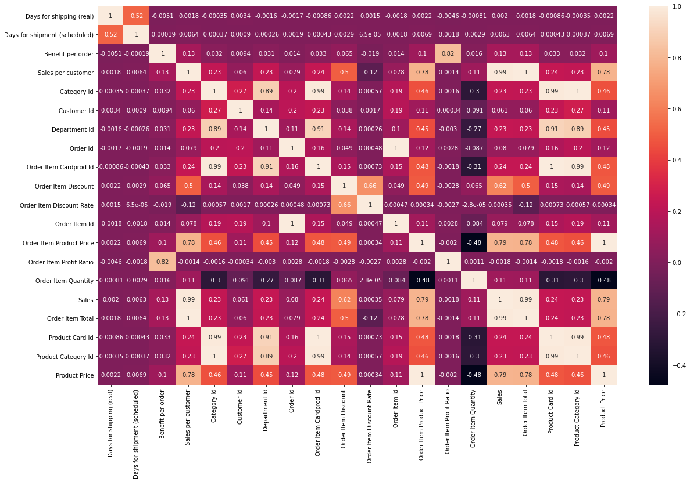
Checking Multicollinearity.
There is a presence of Multicollinearity in the Dataset.
Product Status was the column with zeroes only
Late delivery risk was an encoded categorical column stored as numerical column.
Order Customer Id was dropped as it was same as Customer Id After further analysis, we were left with 20 numerical & 18 categorical columns.
This is the final dimension that went for creating base model.
Label Encoding to be used instead of dummy encoding to reduce the model complexity by keeping the training dimension intact.

Slide 8
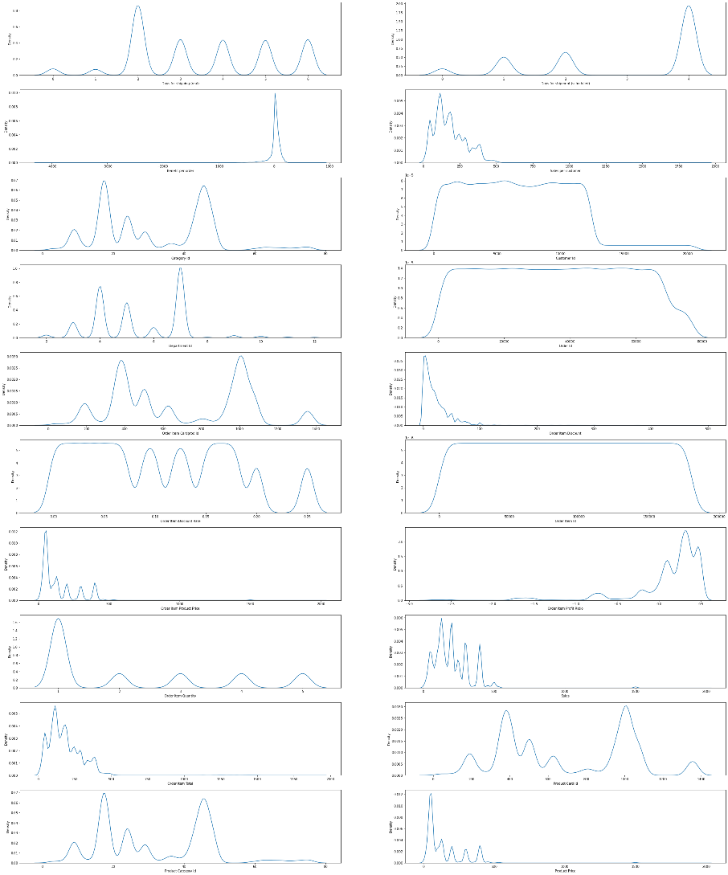
Distribution of Variables:

Slide 9
Presence of outliers and its loss:
Benefit per order, Sales per Customer, Customer Id, Order Customer Id, Order Item Discount, Order Item Product Price, Order Item Profit Ratio, Sales, Order Item Total, Product Price are having outliers.
After performing IQR analysis, we incurred information loss. So, didn’t prefer to do treatment. More than 70% data loss was there.
Statistical Significance of Variables:
Calculated the P-Values for both the Numerical and Categorical Columns.
Customer City, Customer State, Order Country, Order Region, Customer Id,.
These columns had to be dropped for further process as it was seen that the p-values are exponential which stands out and shows its insignificance.

Slide 10
Algorithms, Solution and Conclusions
Assumptions:
Target variable should be numeric – Passed.
There should be less multi – collinearity of the features ---- Passed
Ascertain through statistical test that train & test data represent the overall data
Ttest_indResult (statistic=0.2980565264343673, pvalue=0.7656603642388153)
Base Model Performance
Accuracy of the train data: 0.9774301021659821
Area under the curve AUC on the train: 0.9461652960415097
Accuracy of the test data: 0.9776571386365315
Area under the curve AUC on the test: 0.946080647271054
In this stage of Base model, our model seems to be overfitting. Improvements going further with SMOTE analysis and application of advanced classification algorithms

Slide 11
Thanks!

